Slide 1

Bridging the gap
Microsoft tool, technologies and services for x-platform development
Anders Lybecker | Tech Evangelist | @Lybecker

Slide 2
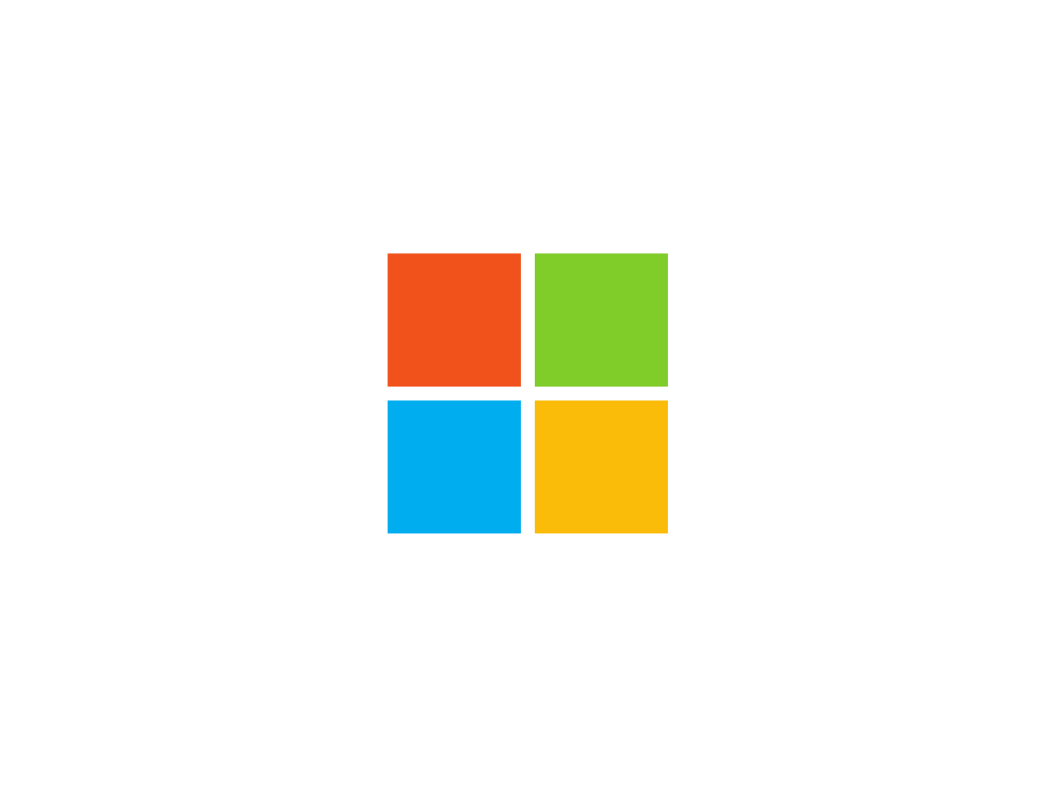

Slide 3

“Our industry
does not respect tradition – it
only respects innovation”

Slide 4


Slide 5

A fork from the past

Slide 6



Great tools

Slide 7
Demo Visual Studio Code

Slide 8
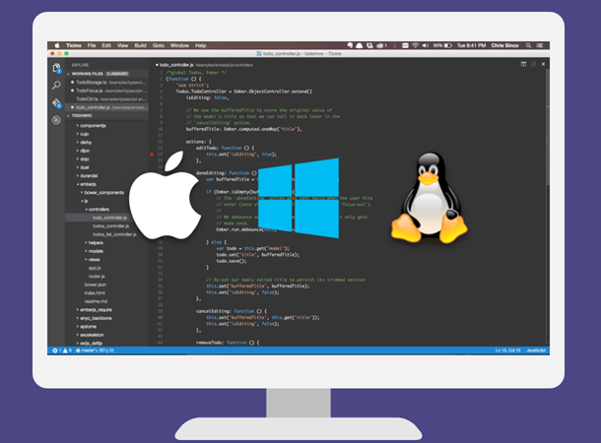
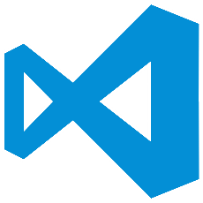
Visual Studio Code 101
Lightweight, cross-plat editor that runs on Windows, OS X and Linux
Provides IntelliSense, colorization, refactoring, etc.
Edit, compile and run app locally
Debugging support
Task runners
Open Source
visualstudio.com

Slide 9
Introducing .NET Core

Slide 10



.NET
WPF
Windows Forms
ASP.NET
(4 & 5)
ASP.NET Core
Universal
Windows Apps
.NET Framework 4.6
.NET Core
CoreCLR
.NET Native runtime
Fully-featured and integrated
.NET libraries and runtime for Windows
Modular and optimized
.NET libraries and runtimes
Shared
Runtime components
Libraries
Compilers
RyuJIT + SIMD
Garbage Collector
Base class libraries
NuGet packages
.NET Compiler Platform (Roslyn)
Languages innovation

Slide 11
.NET Core – changing our tune
Running on Windows
Edit in Viusal Studio
.NET as system component
Run on VM (CLR)
Black box compilers
Proprietary
Run everywhere
Use your favorite editor
Deploy with app
Compile to native
Open compiler APIs
Open source

Slide 12

Azure

Slide 13

24
Azure regions available today
Hyper-scale footprint
More than AWS and Google Cloud combined
Azure regions

Slide 14
Choose your model
Hosting models
Business model
On Premises
Infrastructure
(as a Service)
Platform
(as a Service)
Software
(as a Service)
Applications
Applications
You manage
Applications
Applications
You scale, make resilient and manage
You scale, make
resilient & manage
Data
Data
Data
Data
Runtime
Runtime
Runtime
Runtime
Scale, resilience and management by vendor
Middleware
Middleware
Middleware
Scale, resilience and management by vendor
Middleware
O/S
O/S
O/S
O/S
Virtualization
Virtualization
Managed by vendor
Virtualization
Virtualization
Servers
Servers
Servers
Servers
Storage
Storage
Storage
Storage
Networking
Networking
Networking
Networking

Slide 15







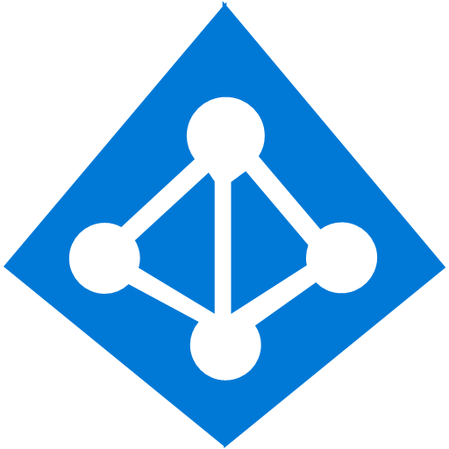























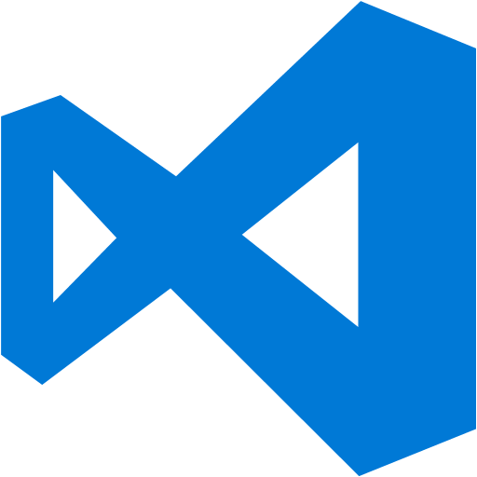



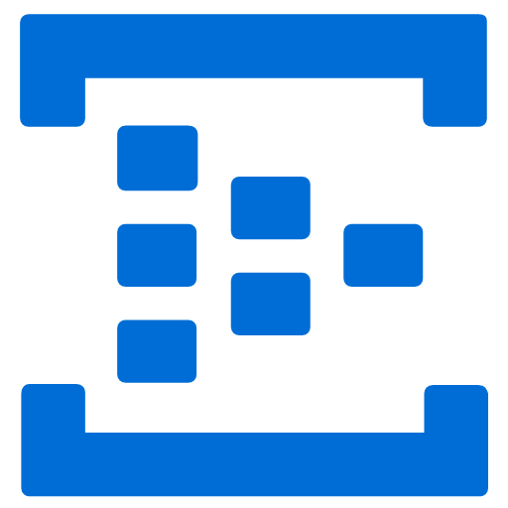

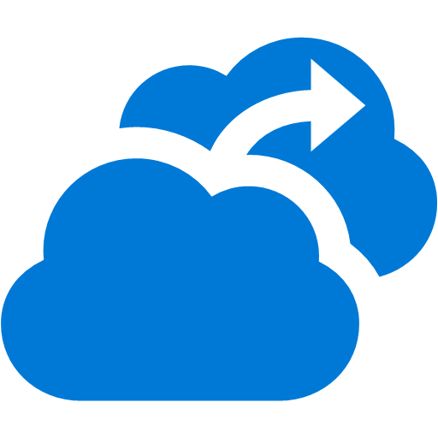







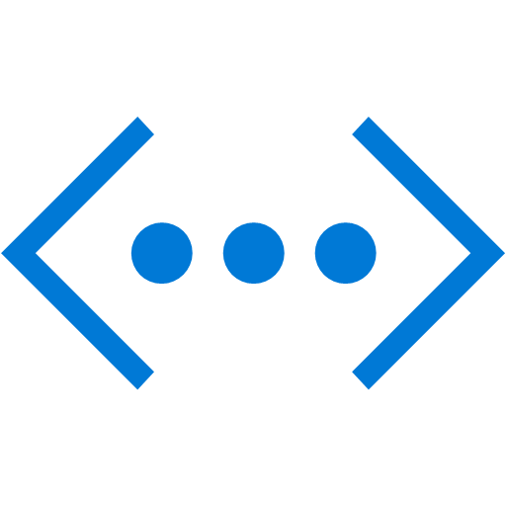






Platform Services
Security & Management
Compute
Web and Mobile
Data
Hybrid
Operations
Cloud
Services
Service
Fabric
Web Apps
API
Apps
Portal
SQL
Database
SQL Data
Warehouse
DocumentDB
Azure AD
Connect Health
Active
Directory
Batch
Remote App
Mobile
Apps
Logic
Apps
Redis
Cache
Search
Tables
AD Privileged
Identity
Management
Multi-Factor
Authentication
Integration
API
Management
Notification
Hubs
Backup
Storage
Queues
Biztalk
Services
Analytics & IoT
Automation
Operational
Insights
Hybrid
Connections
Service
Bus
Developer Services
HDInsight
Machine
Learning
Stream
Analytics
Key Vault
Import/Export
Media & CDN
Visual Studio
Azure SDK
Data
Factory
Event
Hubs
Mobile
Engagement
Store /
Marketplace
Site
Recovery
VM Image Gallery
& VM Depot
Media
Services
Content Delivery
Network (CDN)
Team Project
Application
Insights
StorSimple
Infrastructure Services
Compute
Storage
Networking
Virtual Machines
Containers
BLOB Storage
Azure Files
Premium Storage
Virtual Network
Load Balancer
DNS
Express
Route
Traffic Manager
VPN Gateway
Application Gateway
Datacenter Infrastructure (24 Regions)
Notes:
Why this Slide:
It shows we have a very broad platform. It about BOTH IaaS and PaaS, that these work together. It shows that we continue to lead in world class IT capabilities and that there’s really nothing missing.
Key Points:
We have already seen how the Azure Platform is IaaS + Pass – but I want you to understand that this is a huge number of capabilities – IT building blocks if you will.
Every one of these blocks you provision anytime, self-service anywhere in the world 24x7. You pay for what you use, you can get more or less anytime and you can fully automate everything…
DON’T spent too much time on this slide – you are going to DEMO (aren’t you!!!)… DON’T go through each block…
Transition to NEXT Slide: Make the build go backwards to show JUST IaaS and then you will go to the demo to show it.

Slide 16


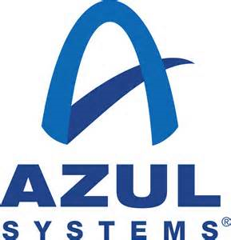










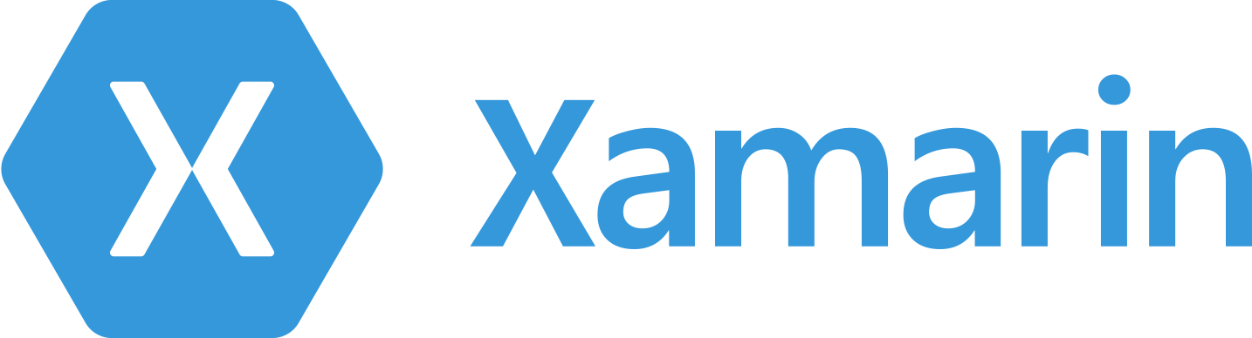
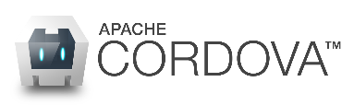







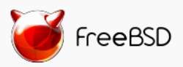
Azure is Open Across the Stack
Microsoft 1st Party Support
Ecosystem Supported
Bring your own framework!
Languages
CMS
Dozens of .NET & PHP CMS and Web applications
Devices
Via cross-platform and native code approaches
Databases
Operating systems
Ubuntu, SUSE, Redhat, CentOS & Oracle EL + hundreds on VM Depot

Slide 17



Summary
Providing the best end-to-end development experience…
…on your terms
Platform
Framework
Tools
…or bring your own
…or bring your own
…or bring your own

Slide 18
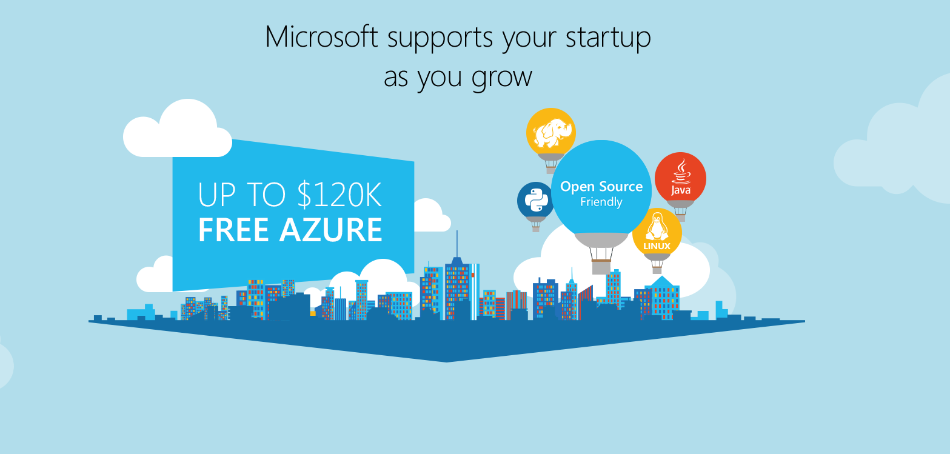
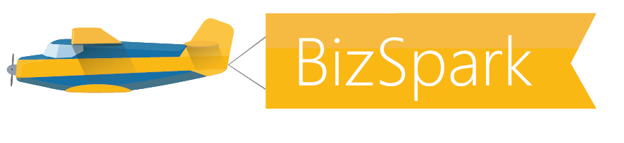

Slide 19
Anders Lybecker | @Lybecker

Slide 21
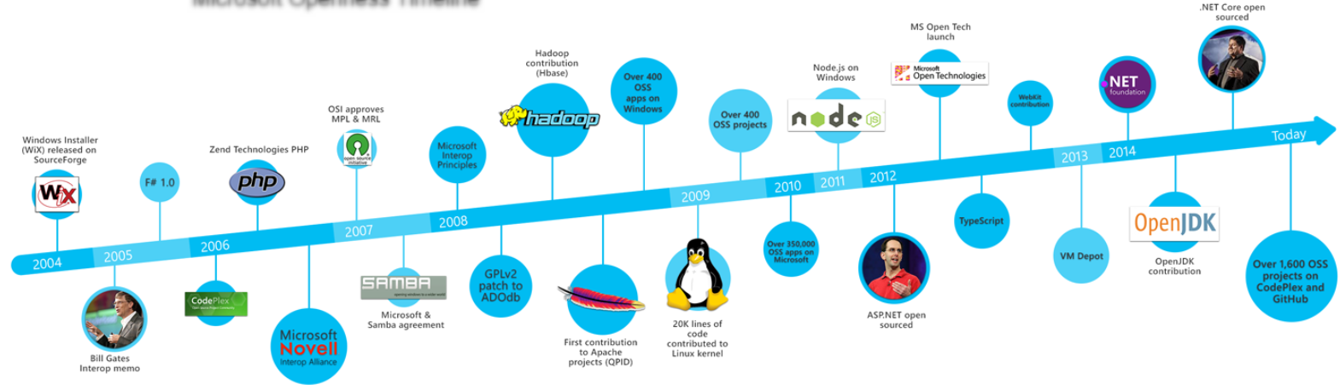
Skype uses 100+ open source libraries
Visual Studio 2015 uses 230

